Slide 1
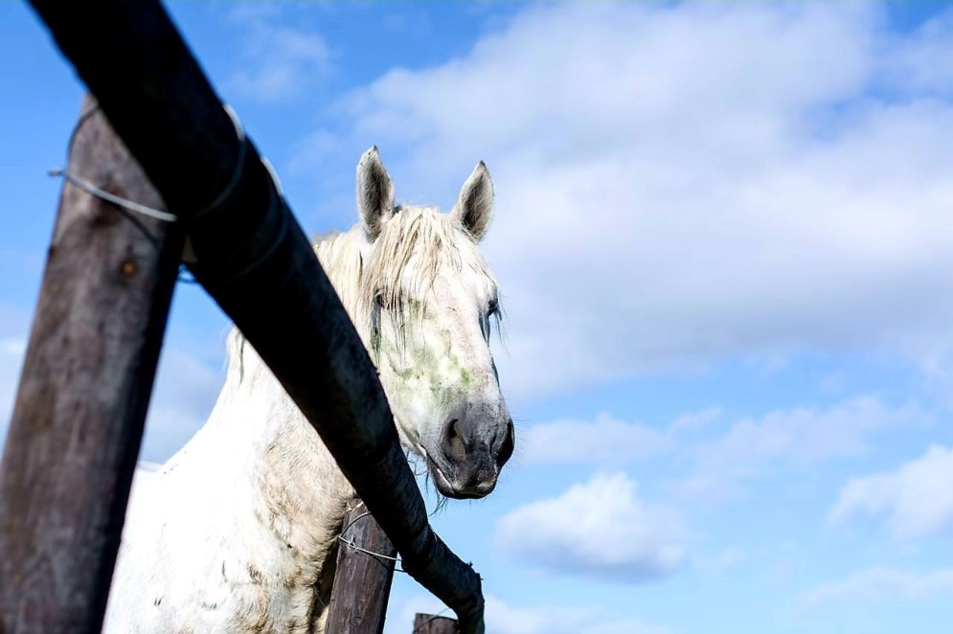
Percherons for sale at livestock expo 2019
Auction at Livestock Expo, Sandringham on 11 October 2019 at 14h00
Contact Person:
Marline Burger

Slide 2
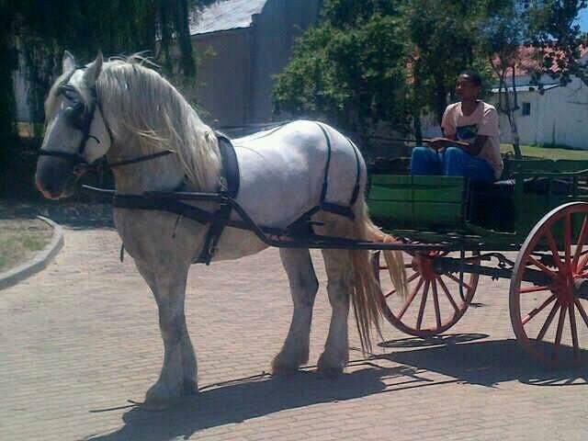
Elsenburg MacKenzie
Stallion
10 years old
Our main actively breeding stallion till 2019
Has been trained to pull a cart
Birth date: 17 October 2009
Passport number: SAEF 2018/3894
Registered at The Percheron Breeders Society of SA (0012771580)
Sire: Elsenburg Missidore
Dam: Elsenburg Marcelle
Microchipped (978000000748535)

Slide 3
Elsenburg MacKenzie - Pedigree
 |  |  | VIADUC 12539615
 |  | ISIDORE 0012538112(IMP)
 |  |  | TACOMA 12539623
 | E. MISSIDORE 0012538187
 |  |  | E. MALAN 709/2
 |  | E. MAZDA 1173/2
 |  |  | E. MARUTSKA 1145/2
E. MACKENZIE 0012771580
 |  |  | E. MEERLUS 664/1
 |  | E. MEIRING 753/2
 |  |  | E. MELROSE 992/2
 | E. MARCELLE 1184/2
 |  |  | E. LENCON 733/2
 |  | E. MEMPHIS 1143/2
 |  |  | E. MELBA 924/1
 | NAGESLAG
VUL | GEBOORTEDATUM | MERRIE | GESLAG
E. MIA | 19/10/2016 | E. MILDRED | MERRIE
E. MANDELA | 22/07/2019 | E. LUCILLE | HINGS
ANOTHER 3 UNBORN FOALS TO ARRIVE OCTOBER/NOVEMBER 2019 BY E. MELISSA, E. MICHAYLA & E. MONTANA

Slide 4
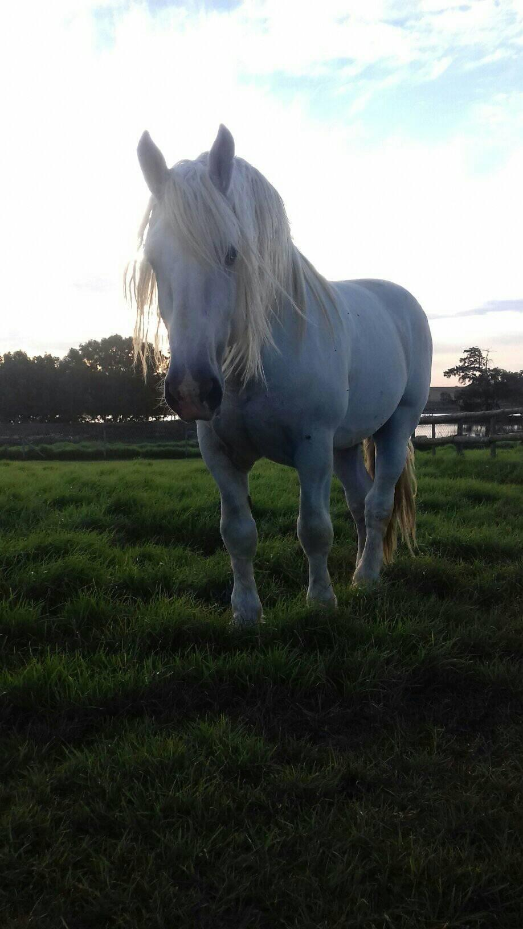
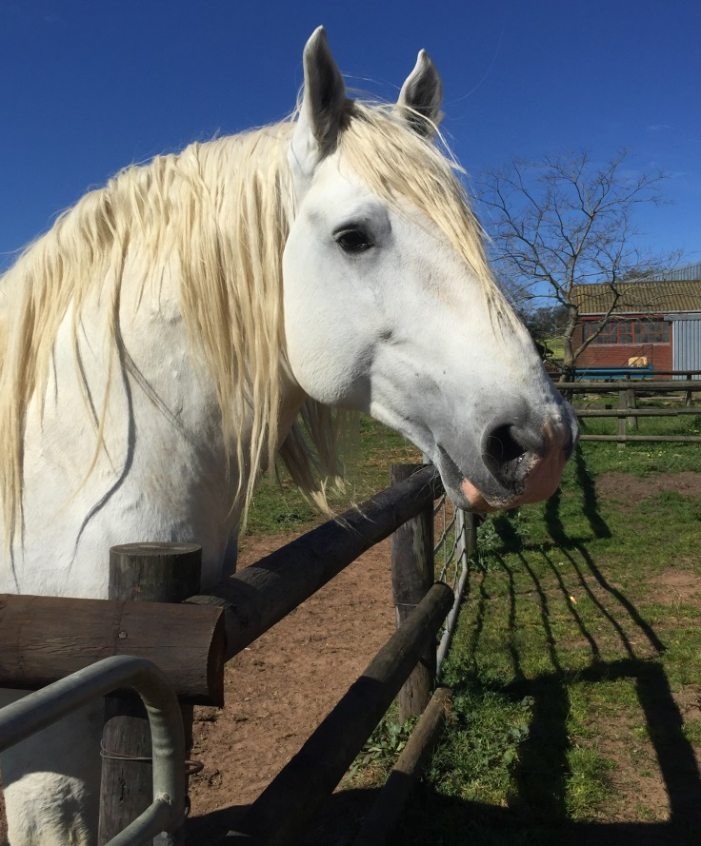
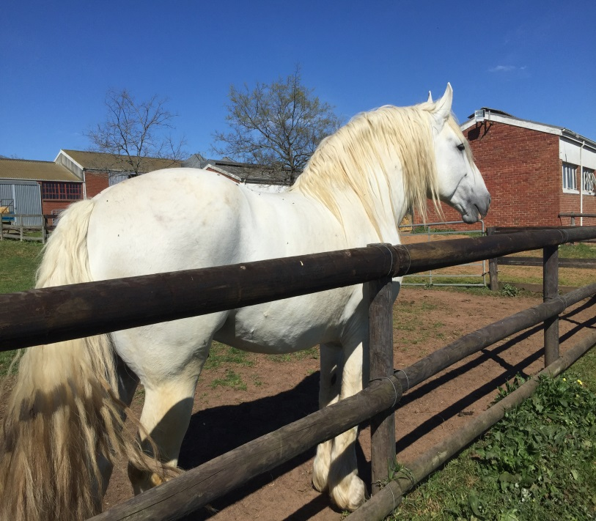
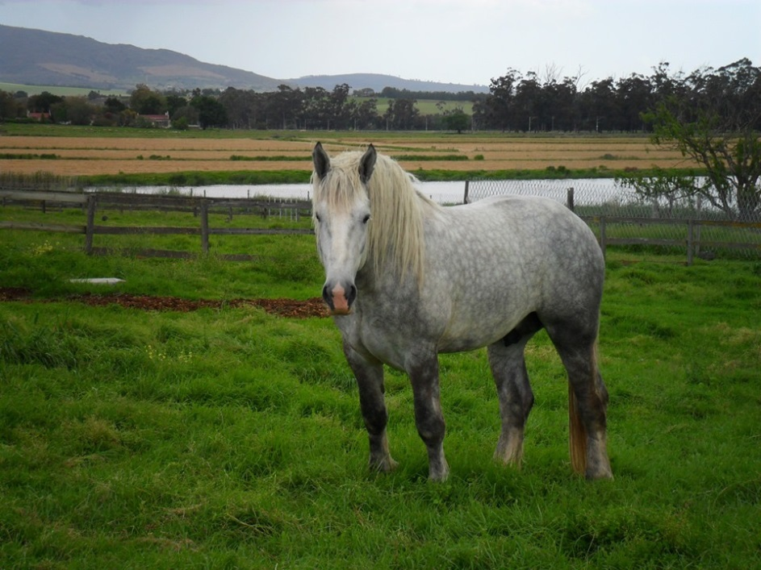
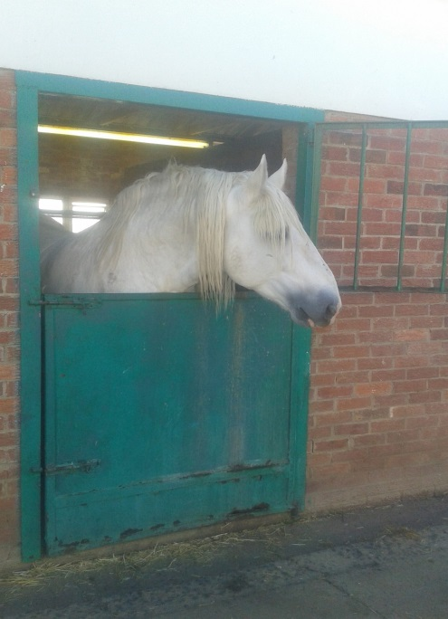
Elsenburg MacKenzie - Gallery

Slide 5
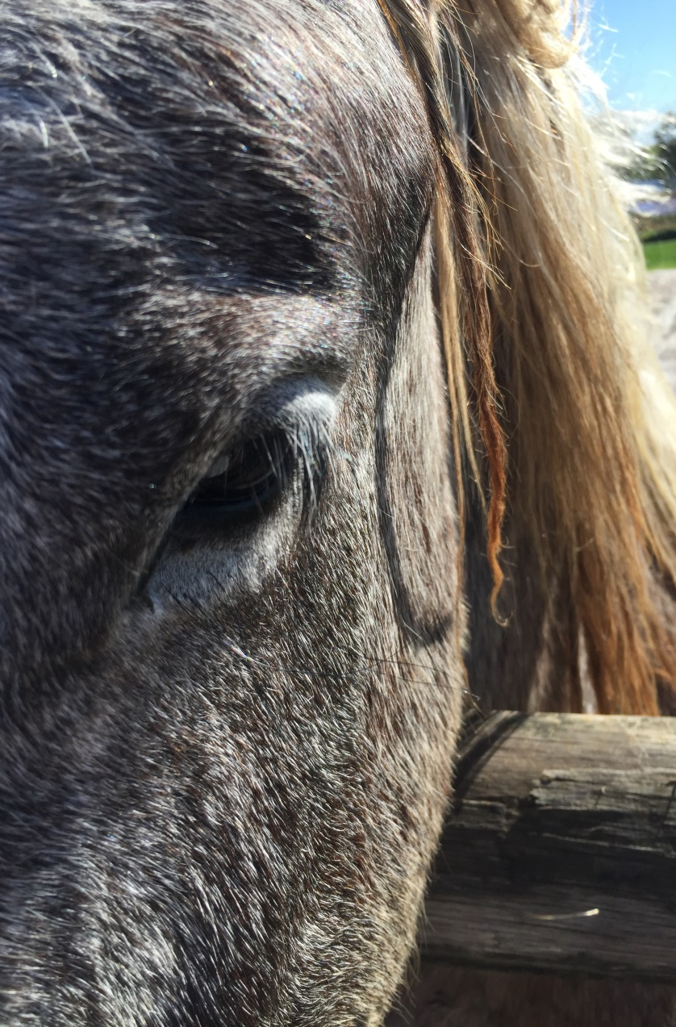
Elsenburg Sebastian
Young colt
Almost 2 years old
Halter tamed and stands for farrier
Birth date: 17 December 2017
Passport number: SAEF 2018/3896
Registered at The Percheron Breeders Society of SA
(0001327666)
Birth notified to The Percheron Breeders Society of SA
(170001)
Not graded/inspected by Society yet
(needs to be 30 months old)
Sire: Vaillant du Chalus (Imported stallion)
Dam: Elsenburg Montana
Microchipped (991001000563057)

Slide 6
Elsenburg Sebastian - Pedigree
 |  |  | JOVIAL (293336)
 |  | OZIAS DU BOURGUERIN (296482)
 |  |  | HERINA (291166)
 | VAILLANT DU CHALUS (IMP)
 |  |  | KEVINE 16 (293576)
 |  | RENAISE DU CHALUS (298733)
 |  |  | NOISETTE DU CHALUS (295522)
E. SEBASTIAN 0001327666
 |  |  | VIADUC 12539615
 |  | ISIDORE 0012538112(IMP)
 |  |  | TACOMA 12539623
 | E. MONTANA 0012538229
 |  |  | E. MERLOT 0011033610
 |  | E. MAVIS 0011466828
 |  |  | E. MELODIE 0011032083

Slide 7
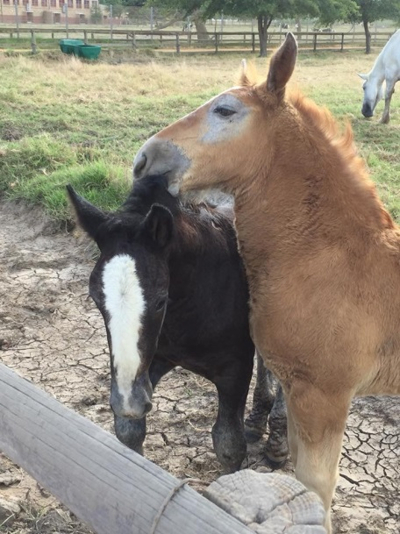
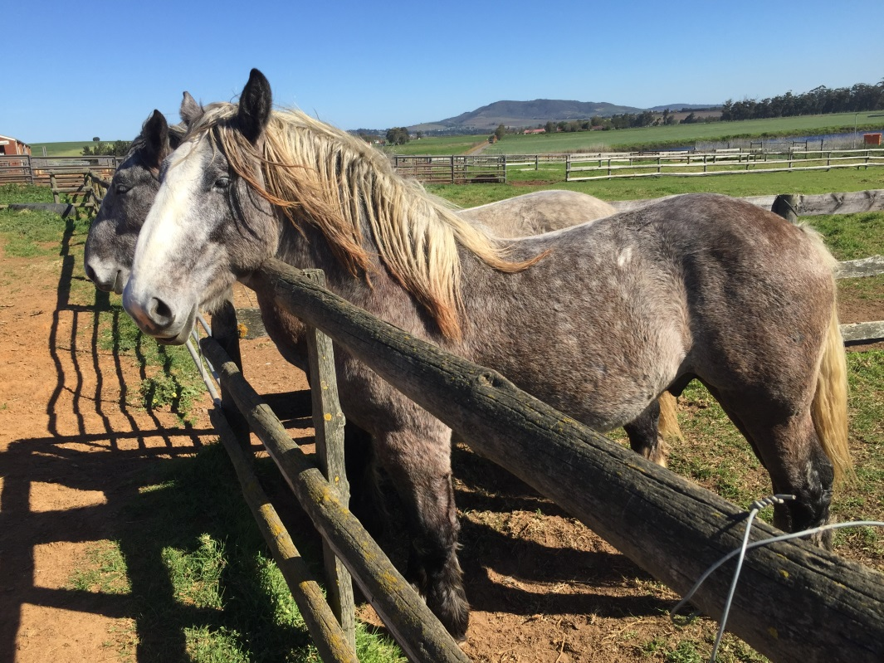
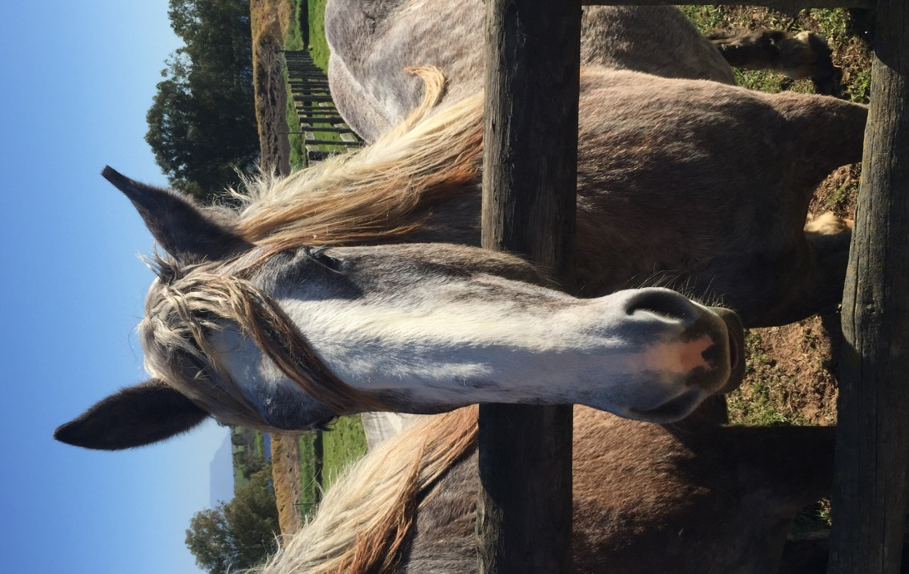
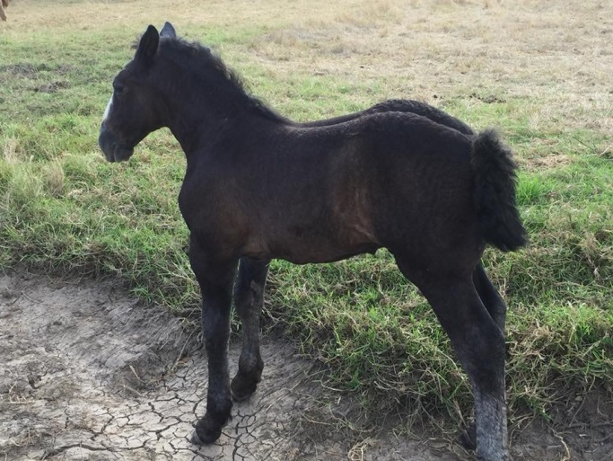
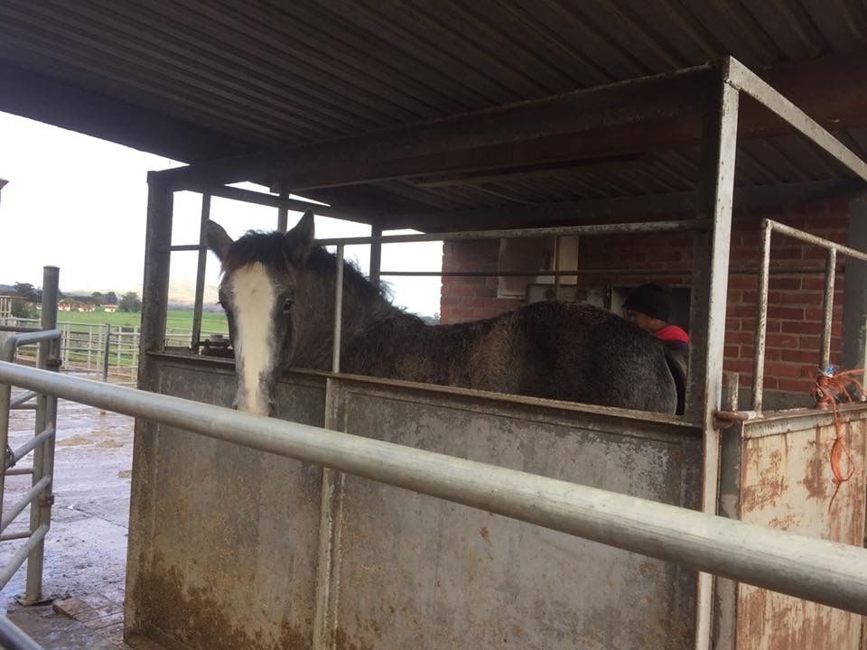
Elsenburg Sebastian - Gallery

Slide 8
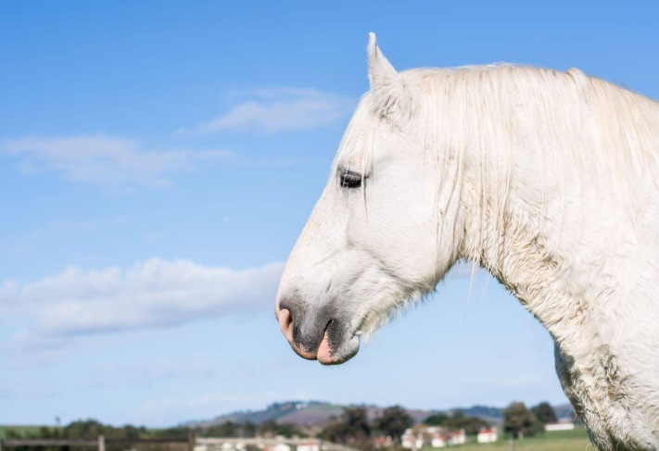
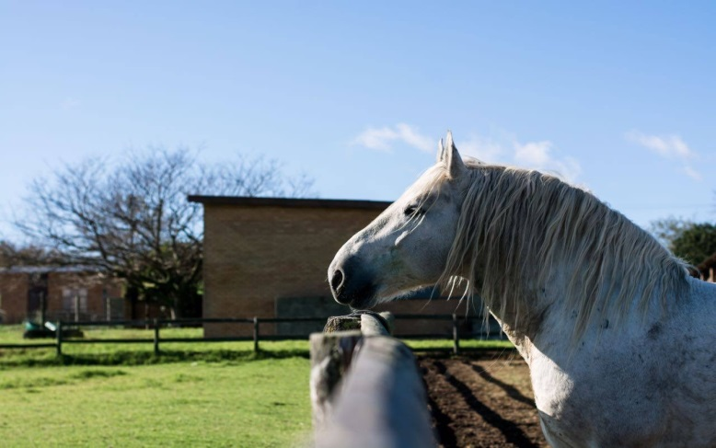
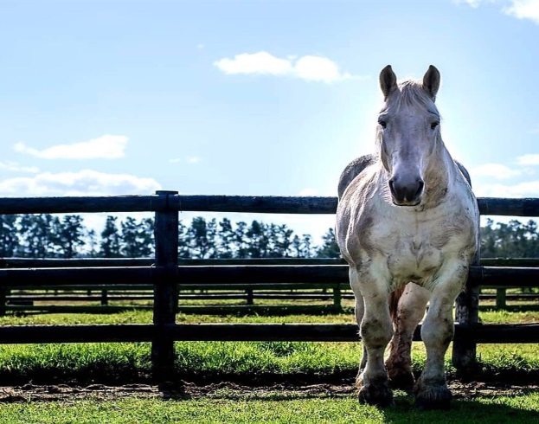
Marliné Burger
Animal Sciences
+27 (21 808 5375)
+27 (21 808 5407)
marlineb@elsenburg.com

